Slide 1
Data Mining
Lecture 12

Slide 2
Course Syllabus
Classification Techniques (Week 7- Week 8- Week 9)
  Inductive Learning
  Decision Tree Learning
  Association Rules
  Neural Networks
  Regression
  Probabilistic Reasoning
  Bayesian Learning
  Lazy Learning
  Reinforcement Learning
  Genetic Algorithms
  Support Vector Machines
  Fuzzy Logic

Slide 3
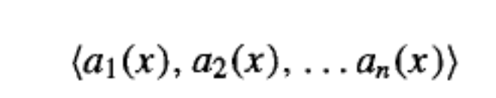
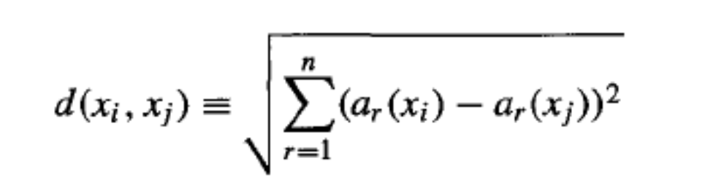
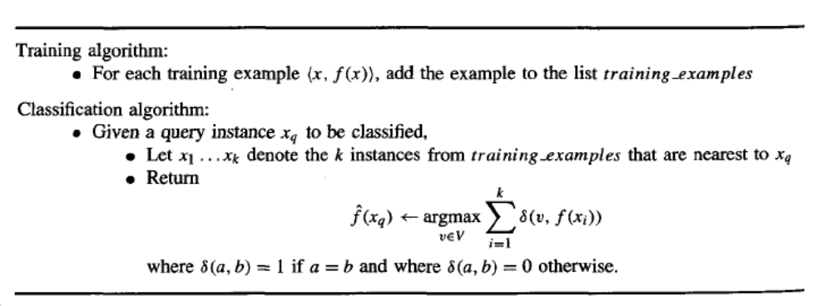
Lazy Learning k- Nearest Neighbour Method
let an arbitrary instance x be described by the attribute vector
the distance between two instances can be defined in Euclidean form:

Slide 4
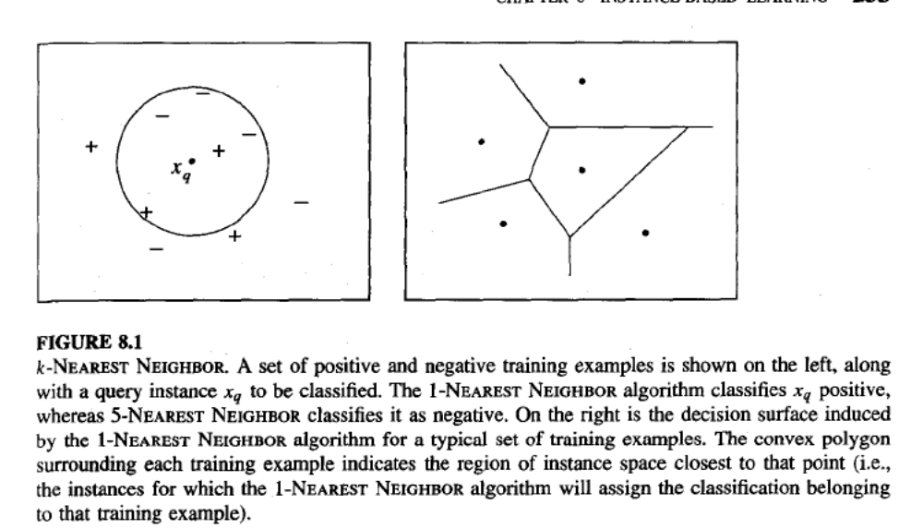
k- Nearest Neighbour Method

Slide 5
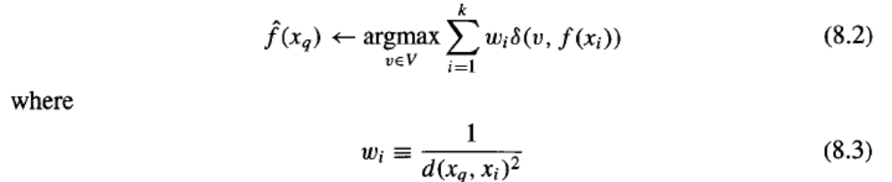
k- Nearest Neighbour Method
What about distance-weighted classification?
The weight of the every training input instance’s decision will be porportional to it’s distance to target(query instance)
Closer >>>More Important
Far >>>Less Important

Slide 6

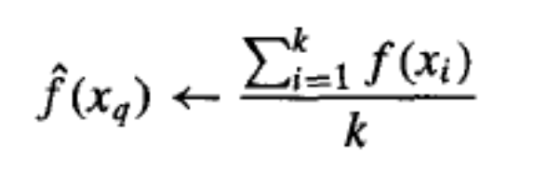
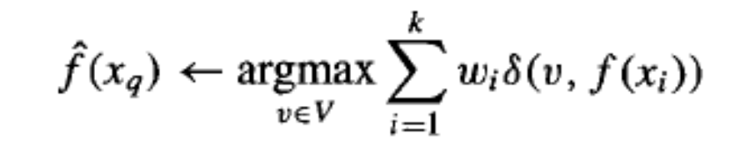

k- Nearest Neighbour Method
Un-weighted:
Discrete valued
Continuous Valued
Weighted:
Discrete valued
Continuous Valued

Slide 7
k- Nearest Neighbour Method – Curse of Dimensionality
If the distance between neighbors will be dominated by the large number of irrelevant attributes then mis-calculation of distance occurs.
This situation arises many irrelevant attributes are present, is sometimes referred to as the curse of dimensionality. Nearest-neighbor approaches are especially sensitive to this problem
Solutions:
Simply weigh attributes according to its importance
Just ignore the irrelevant attributes

Slide 8
k- Nearest Neighbour Method – Lazy Learners
Neighbouring Methods won’t learn till a classification problem arises.
For every classification instance different decision making mechanism can be built. Thats why lazy learners can also be called as ”Local Learners”
There is no training cost; but classification cost can be quite high
Curse of dimensionality is another big problem

Slide 9
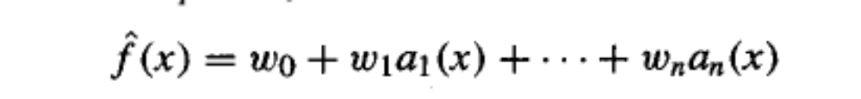
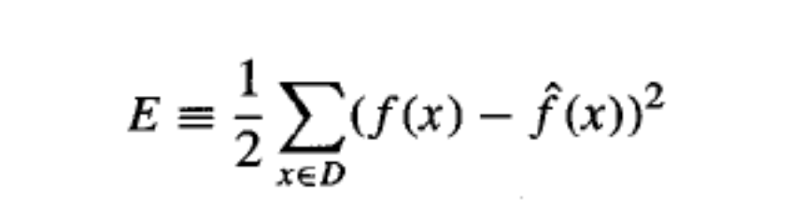
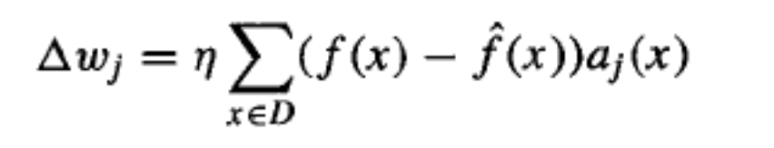
k- Nearest Neighbour Method – Locally Weighted Linear Regression
How shall we modify this procedure to derive a local approximation rather
than a global one? The simple way is to redefine the error criterion E to emphasize fitting the local training examples

Slide 10
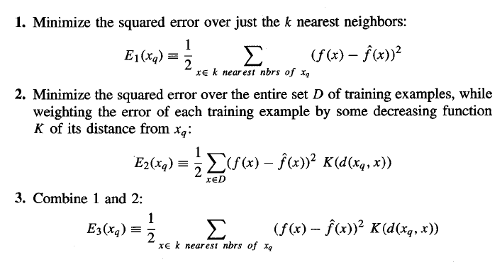

k- Nearest Neighbour Method – Locally Weighted Linear Regression

Slide 11
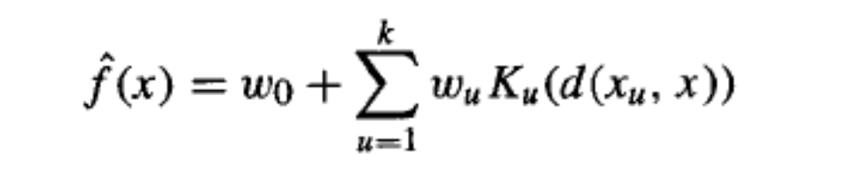
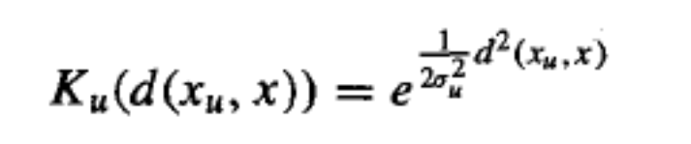
k- Nearest Neighbour Method – Radial Basis Functions
One approach to function approximation that is closely related to distance-weighted regression and also to artificial neural networks is learning with radial basis functions (Powell 1987; Broomhead and Lowe 1988; Moody and Darken 1989). In this approach, the learned hypothesis is a function of the form:
where Kernel functions localized for every instance or group of instances.
Kernel function also uses the distance function for decision making; if distance
increases importance decreases and vice versa

Slide 12
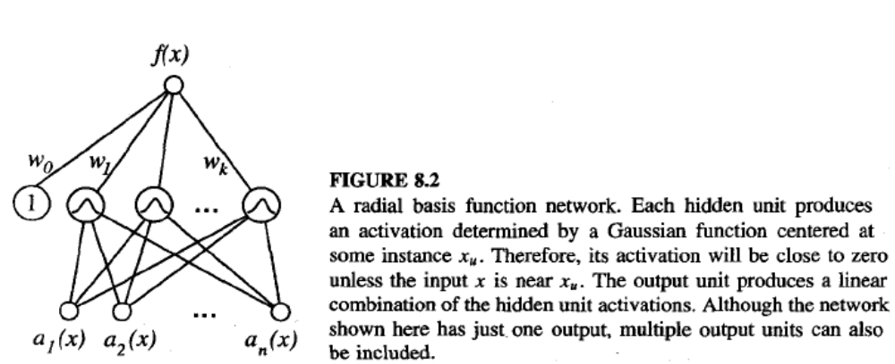
k- Nearest Neighbour Method – Radial Basis Functions

Slide 13
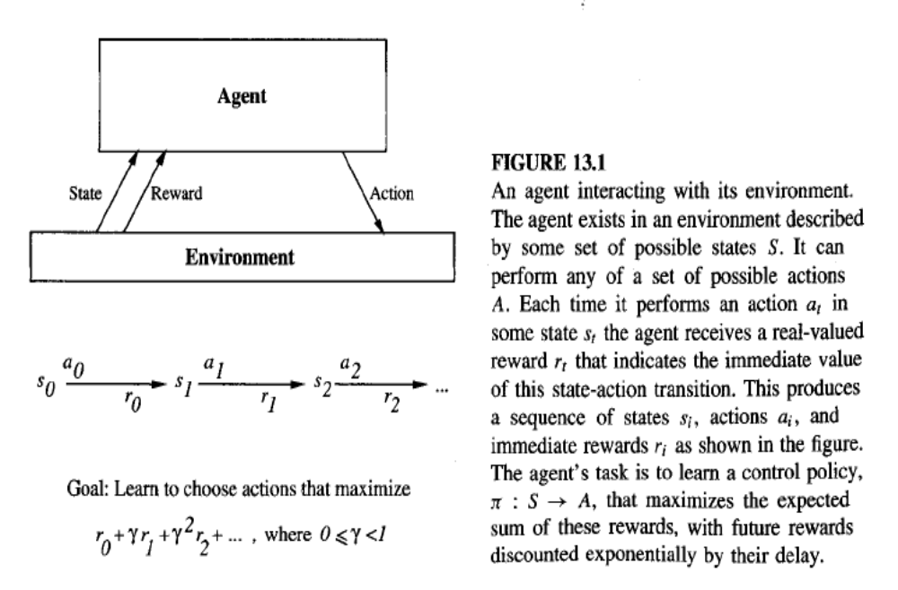
Reinforcement Learning

Slide 14
Reinforcement Learning
Reinforcement learning addresses the problem of learning control strategies for autonomous agents. It assumes that training information is available in the form of a real-valued reward signal given for each state-action transition.The goal of the agent is to learn an action policy that maximizes the total reward it will receive from any starting state
Markov decision processes,the outcome of applying any action to any state depends only on this action and state (and not on preceding actions:or states). Markov decision processes cover a wide range of problems including many robot control,factory automation, and scheduling problems.

Slide 15
Reinforcement Learning
Reinforcement learning is closely related to dynamic programming approaches to Markov decision processes. The key difference is that historically these dynamic programming approaches have assumed that the agent possesses knowledge of the state transition function 6(s, a) and reward function r (s , a). In contrast, reinforcement learning algorithms such as Q learning typically assume the learner lacks such knowledge.

Slide 16
Genetic Algorithms
- Models Of Evolution and Learning
LAMARCKIAN EVOLUTION THEORY
Lamarck was a scientist who, in the late nineteenth century, proposed that evolution over many generations was directly influenced by the experiences of individual organisms during their lifetime. In particular, he proposed that experiences of a single organism directly affected the genetic makeup of their offspring: If an individual learned during its lifetime to avoid some toxic food, it could pass this trait on genetically to its offspring, which therefore would not need to learn the trait

Slide 17
Genetic Algorithms
- Models Of Evolution and Learning
BALDWIN EFFECT
If a species is evolving in a changing environment, there will be evolutionary
pressure to favor individuals with the capability to learn during their
lifetime. For example, if a new predator appears in the environment, then
individuals capable of learning to avoid the predator will be more successful
than individuals who cannot learn. In effect, the ability to learn allows an
individual to perform a small local search during its lifetime to maximize its
fitness. In contrast, nonlearning individuals whose fitness is fully determined
by their genetic makeup will operate at a relative disadvantage.
Those individuals who are able to learn many traits will rely less strongly
on their genetic code to "hard-wire" traits. As a result, these individuals
can support a more diverse gene pool, relying on individual learning to
overcome the "missing" or "not quite optimized" traits in the genetic code.
This more diverse gene pool can, in turn, support more rapid evolutionary
adaptation. Thus, the ability of individuals to learn can have an indirect
accelerating effect on the rate of evolutionary adaptation for the entire population.

Slide 18
Genetic Algorithms - Remarks
Genetic algorithms (GAS) conduct controlled-randomized, parallel, hill-climbing search for hypotheses that optimize a predefined fitness function.
GAS illustrate how learning can be viewed as a special case of optimization.In particular, the learning task is to find the optimal hypothesis, according to the predefined fitness function. This suggests that other optimization techniques such as simulated annealing can also be applied to machine learning problems.
Genetic programming is a variant of genetic algorithms in which the hypotheses being manipulated are computer programs rather than bit strings. Operations such as crossover and mutation are generalized to apply to programs rather than bit strings. Genetic programming has been demonstrated to learn programs for tasks such as simulated robot control (Koza 1992) and recognizing objects in visual scenes (Teller and Veloso 1994).

Slide 19
Associations
In data mining, association rule learning is a popular and well researched method for discovering interesting relations between variables in large databases. Piatetsky-Shapiro [1] describes analyzing and presenting strong rules discovered in databases using different measures of interestingness. Based on the concept of strong rules, Agrawal et al. [2]
introduced association rules for discovering regularities between products in large scale transaction data recorded by point-of-sale (POS) systems in supermarkets. For example, the rule found in the sales data of a supermarket would indicate that if a customer buys onions and potatoes together, he or she is likely to also buy beef. Such information can be used as the basis for decisions about marketing activities such as, e.g., promotional pricing or . In addition to the above example from market basket analysis association rules are employed today in many application areas including Web usage mining, intrusion detection and bioinformatics.

Slide 20
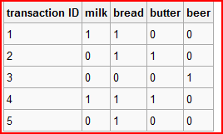
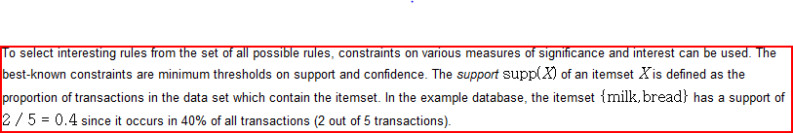
Associations

Slide 21
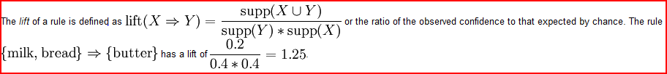
Associations

Slide 22
Associations
Frequent Itemsets Property- Apriori principle
The methods used to find frequent itemsets are based on the following properties –
Every subset of a frequent itemset is also frequent. Algorithms make use of this property in the following way – we need not find the count of an itemset, if all its subsets are not frequent. So, we can first find the counts of some short itemsets in one pass of the database. Then consider longer and longer itemsets in subsequent passes. When we consider a long itemset, we can make sure that all its subsets are frequent. This can be done because we already have the counts of all those subsets in previous passes.

Slide 23
Associations
Let us divide the tuples of the database into partitions, not necessarily of equal size. Then an itemset can be frequent only if it is frequent in atleast one partition. This property enables us to apply divide and conquer type algorithms. We can divide the database into partitions and
find the frequent itemsets in each partition. An itemset can be frequent only if it is frequent in atleast one of these partitions. To see that this is true, consider k partitions of sizes n1, n2,..., nk.
Let minimum support be s.Consider an itemset which does not have minimum support in any partition. Then its count in each partition must be less than sn1, sn2,..., snk respectively. Therefore its total count must be less than the sum of all these counts, which is s( n1 + n2 +...+ nk ).
This is equal to s*(size of database). Hence the itemset is not frequent in the entire database.

Slide 24
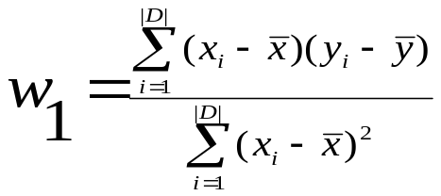

Linear Regression
Linear regression: involves a response variable y and a single predictor variable x
    y = w₀ + w₁ x
  where w₀ (y-intercept) and w₁ (slope) are regression coefficients
Method of least squares: estimates the best-fitting straight line
Multiple linear regression: involves more than one predictor variable
  Training data is of the form (X₁, y₁), (X₂, y₂),…, (X_{|D|}, y_{|D|})
  Ex. For 2-D data, we may have: y = w₀ + w₁ x₁+ w₂ x₂
  Solvable by extension of least square method or using SAS, S-Plus
  Many nonlinear functions can be transformed into the above

Slide 25
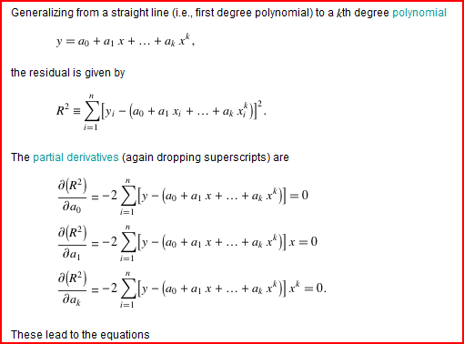
Least Squares Fitting

Slide 26
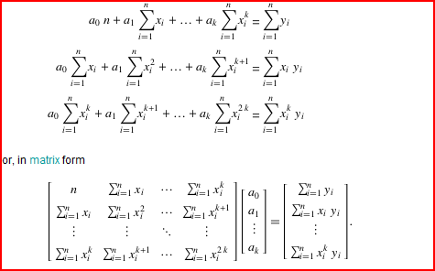
Linear Regression

Slide 27
Nonlinear Regression
Some nonlinear models can be modeled by a polynomial function
A polynomial regression model can be transformed into linear regression model. For example,
    y = w₀ + w₁ x + w₂ x² + w₃ x³
  convertible to linear with new variables: x₂ = x², x₃= x³
    y = w₀ + w₁ x + w₂ x₂ + w₃ x₃
Other functions, such as power function, can also be transformed to linear model
Some models are intractable nonlinear (e.g., sum of exponential terms)
  possible to obtain least square estimates through extensive calculation on more complex formulae

Slide 28
Other Regression-Based Models
Generalized linear model:
  Foundation on which linear regression can be applied to modeling categorical response variables
  Variance of y is a function of the mean value of y, not a constant
  Logistic regression: models the prob. of some event occurring as a linear function of a set of predictor variables
  Poisson regression: models the data that exhibit a Poisson distribution
Log-linear models: (for categorical data)
  Approximate discrete multidimensional prob. distributions
  Also useful for data compression and smoothing
Regression trees and model trees
  Trees to predict continuous values rather than class labels

Slide 29
SVM—Support Vector Machines
A new classification method for both linear and nonlinear data
It uses a nonlinear mapping to transform the original training data into a higher dimension
With the new dimension, it searches for the linear optimal separating hyperplane (i.e., “decision boundary”)
With an appropriate nonlinear mapping to a sufficiently high dimension, data from two classes can always be separated by a hyperplane
SVM finds this hyperplane using support vectors (“essential” training tuples) and margins (defined by the support vectors)

Slide 30
SVM—History and Applications
Vapnik and colleagues (1992)—groundwork from Vapnik & Chervonenkis’ statistical learning theory in 1960s
Features: training can be slow but accuracy is high owing to their ability to model complex nonlinear decision boundaries (margin maximization)
Used both for classification and prediction
Applications:
  handwritten digit recognition, object recognition, speaker identification, benchmarking time-series prediction tests

Slide 31
SVM—General Philosophy
Small Margin
Large Margin
Support Vectors

Slide 32


SVM—Margins and Support Vectors

Slide 33
SVM—When Data Is Linearly Separable
m
Let data D be (X₁, y₁), …, (X_{|D|}, y_{|D|}), where X_{i} is the set of training tuples associated with the class labels y_{i}
There are infinite lines (hyperplanes) separating the two classes but we want to find the best one (the one that minimizes classification error on unseen data)
SVM searches for the hyperplane with the largest margin, i.e., maximum marginal hyperplane (MMH)

Slide 34
SVM—Linearly Separable
A separating hyperplane can be written as
    W ● X + b = 0
  where W={w₁, w₂, …, w_{n}} is a weight vector and b a scalar (bias)
For 2-D it can be written as
    w₀ + w₁ x₁ + w₂ x₂ = 0
The hyperplane defining the sides of the margin:
    H₁: w₀ + w₁ x₁ + w₂ x₂ ≥ 1 for y_{i} = +1, and
    H₂: w₀ + w₁ x₁ + w₂ x₂ ≤ – 1 for y_{i} = –1
Any training tuples that fall on hyperplanes H₁ or H₂ (i.e., the
sides defining the margin) are support vectors
This becomes a constrained (convex) quadratic optimization problem: Quadratic objective function and linear constraints → Quadratic Programming (QP) → Lagrangian multipliers

Slide 35
Why Is SVM Effective on High Dimensional Data?
The complexity of trained classifier is characterized by the # of support vectors rather than the dimensionality of the data
The number of support vectors found can be used to compute an (upper) bound on the expected error rate of the SVM classifier, which is independent of the data dimensionality
Thus, an SVM with a small number of support vectors can have good generalization, even when the dimensionality of the data is high

Slide 36
SVM vs. Neural Network
SVM
  Relatively new concept
  Deterministic algorithm
  Nice Generalization properties
  Hard to learn – learned in batch mode using quadratic programming techniques
  Using kernels can learn very complex functions
Neural Network
  Relatively old
  Nondeterministic algorithm
  Generalizes well but doesn’t have strong mathematical foundation
  Can easily be learned in incremental fashion
  To learn complex functions—use multilayer perceptron (not that trivial)

Slide 37

Fuzzy Logic
Fuzzy logic uses truth values between 0.0 and 1.0 to represent the degree of membership (such as using fuzzy membership graph)
Attribute values are converted to fuzzy values
  e.g., income is mapped into the discrete categories {low, medium, high} with fuzzy values calculated
For a given new sample, more than one fuzzy value may apply
Each applicable rule contributes a vote for membership in the categories
Typically, the truth values for each predicted category are summed, and these sums are combined

Slide 38
End of Lecture
read Chapter 6 of Course Text Book
read Chapter 6 – Supplemantary Text Book “Machine Learning” – Tom Mitchell

